Slide 1
Natural Language Processing
Unit 6 Lexical databases and knowledge graphs
Faizan Javed
DataScience @ SMU

Slide 2
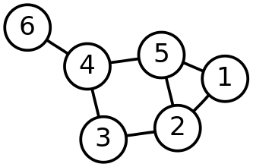
What is a graph?
Graphs are a powerful and versatile data structure that easily allow you to represent relationships between different types of data (nodes).
There are two main parts of a graph:
The vertices (nodes) where the data is stored i.e. the numbers in the image on the left
The edges (connections) which connect the nodes i.e. the lines between the numbers in the image

Slide 3
Relational Databases vs Knowledge Graphs
Schemas store different tables
Tables have a set of columns and rows and each row is an observation
There is a relationship between tables.
Data in tables is more important than the relationships between tables.
Local restaurant chain DB:
Table 1: customer information in one database table
Table 2: items for sale
Table 3: sales transactions

Slide 4
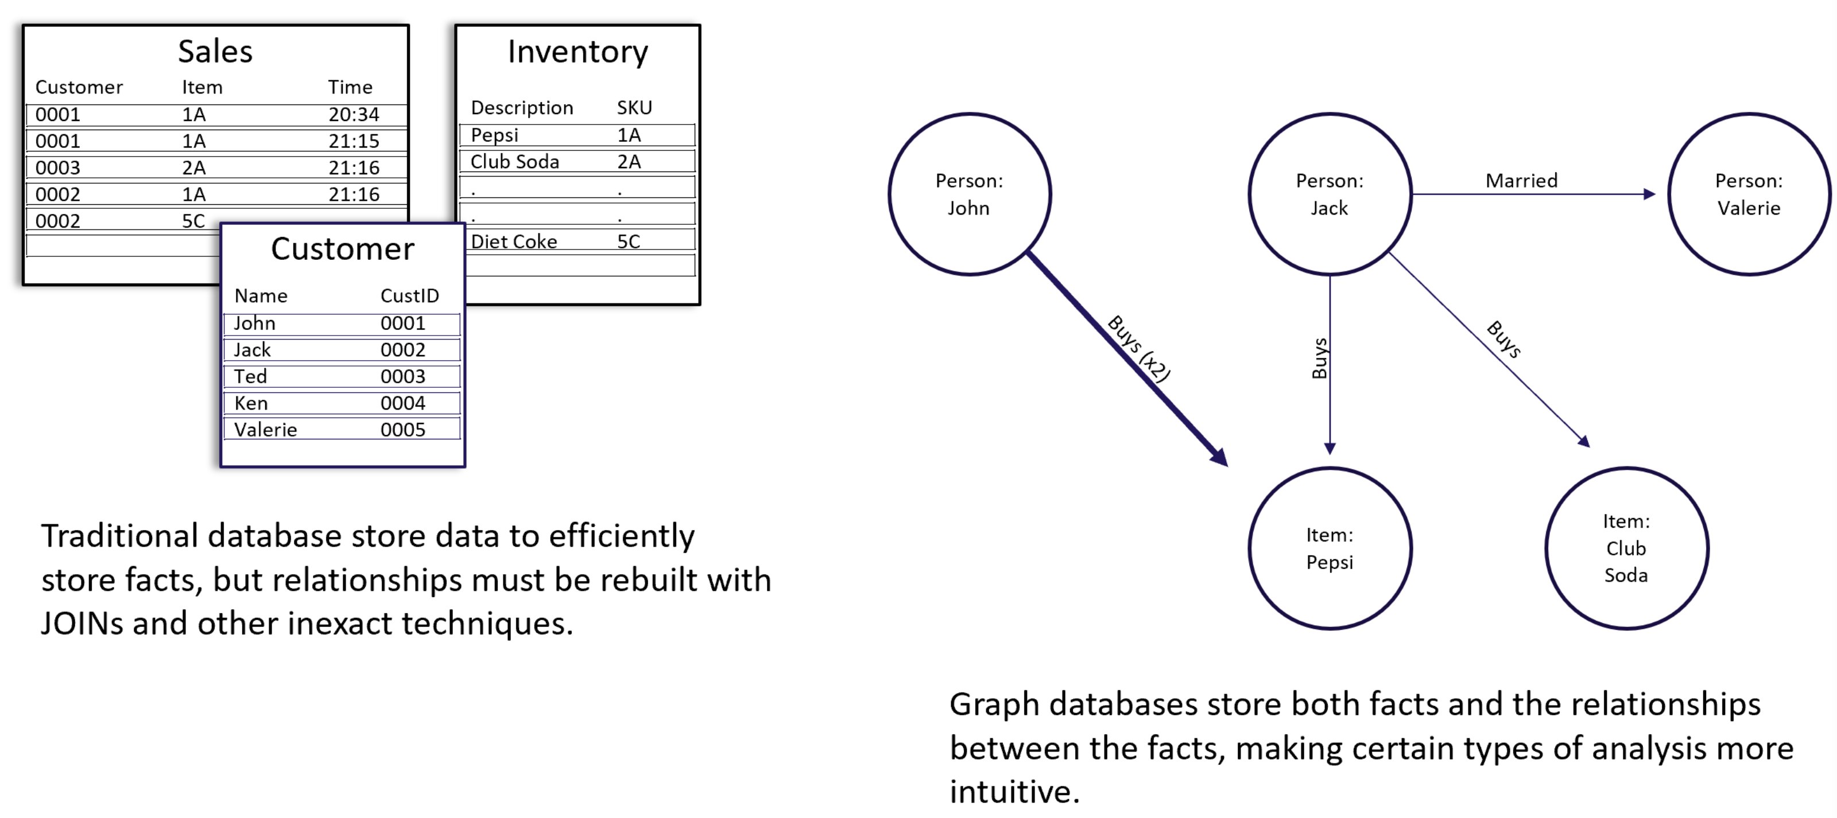
"John buys a lot of Pepsi, Jack is married to Valerie and buys different drinks."
Can see the relationships in the data without having to make a hypothesis and testing it.
RDBs: highly-structured data in tables with pre-determined columns and rows,
Graphs: are not rigid in their organization and structure, can map multiple types of relational and complex data.

Slide 5
Lexical Knowledge Bases
Organize words into senses
Link those senses via relations such as :
Synonym/antonym: a word or phrase that means exactly or nearly the same as another word or phrase in the same language.
E.g., USA, America
Hyponym/hypernym: Hyponymy shows the relationship between a generic term (hypernym) and a specific instance of it (hyponym).
Holonym/meronym (whole-part):
the relationship between a term denoting the whole and a term
denoting a part of, or a member of, the whole.
E.g., Tree → bark, trunk, limb

Slide 6
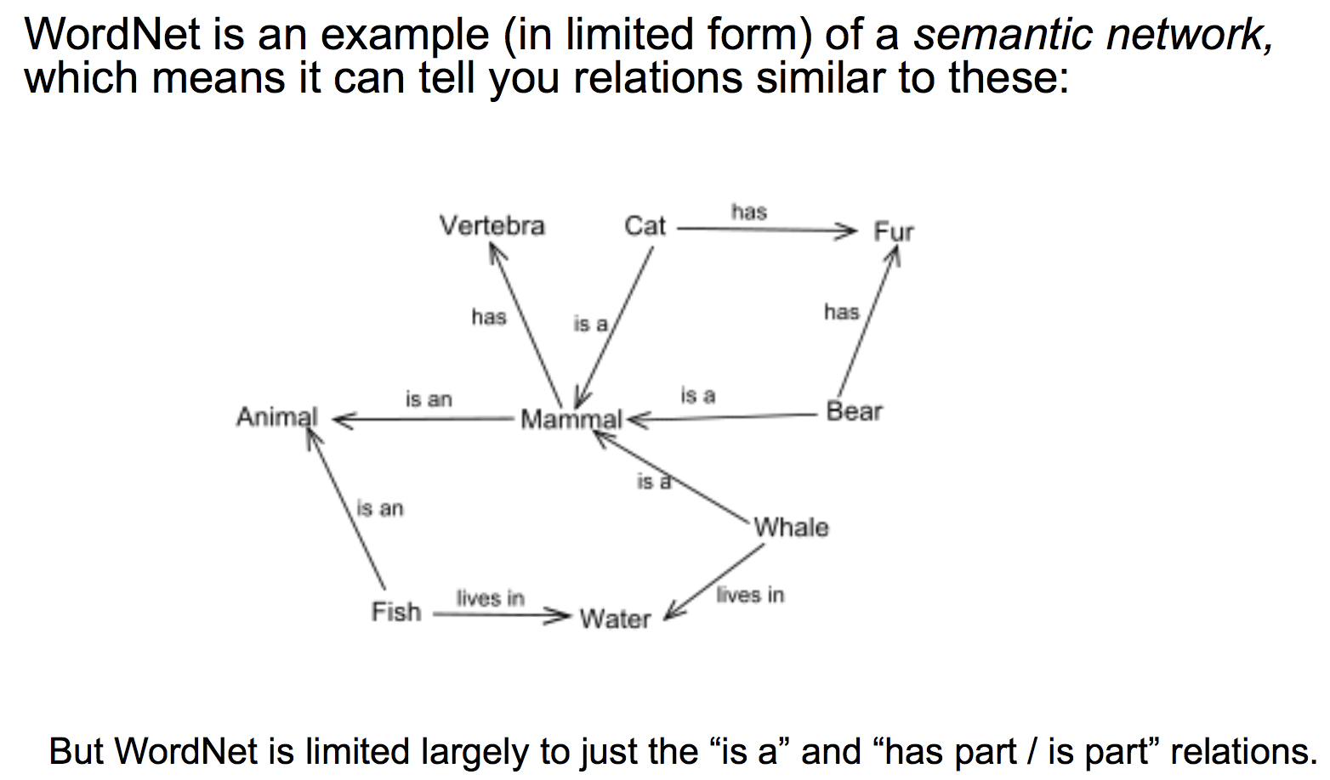
WordNet

Slide 7
Taxonomies and Ontologies
Taxonomy
Hierarchical organization of entities.
Parent-child “is-a” relationships
Ontology
Arbitrary complex relationships between entities.
Is-a, has-a, uses-a .. non-hierarchical relationships

Slide 8
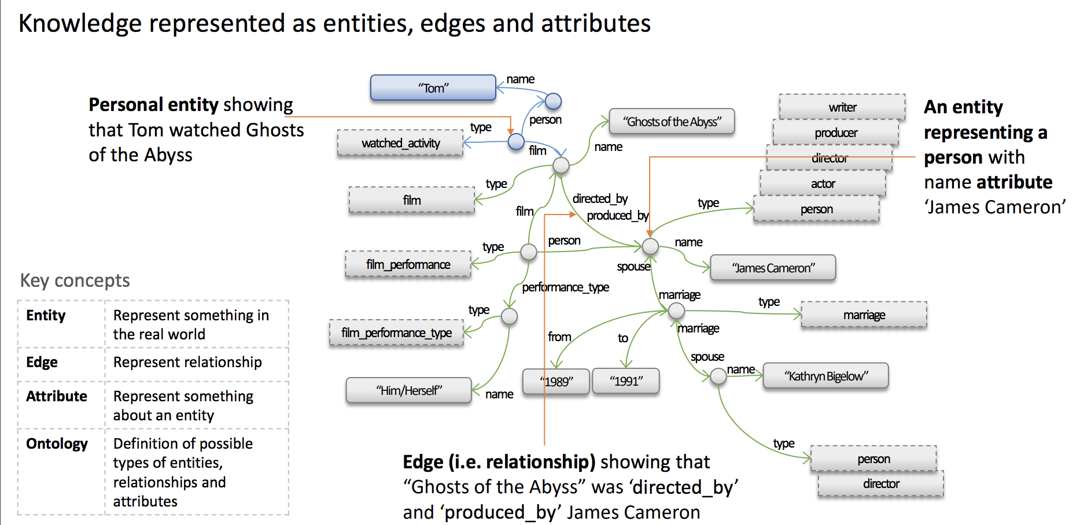
Knowledge graphs KDD-2018 tutorial https://kdd2018tutorialt39.azurewebsites.net/

Slide 9
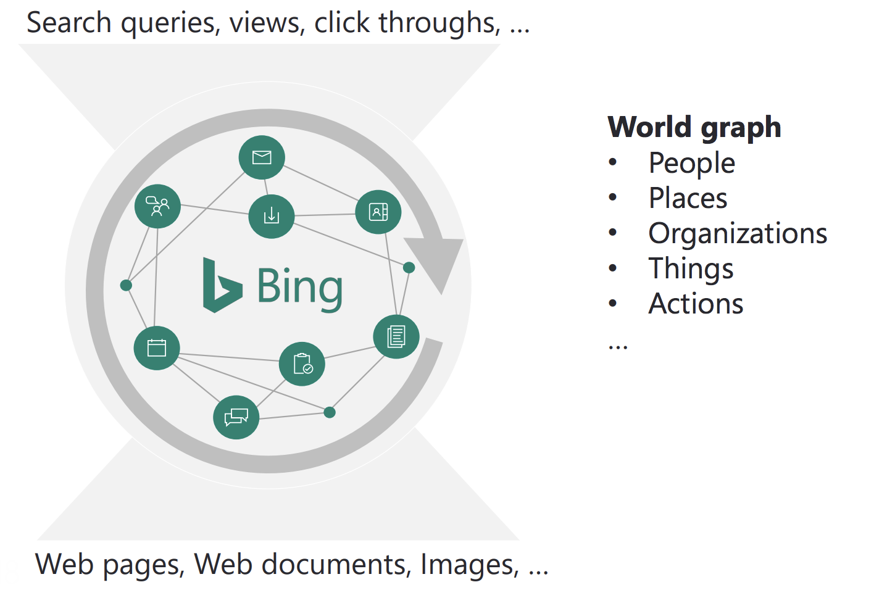
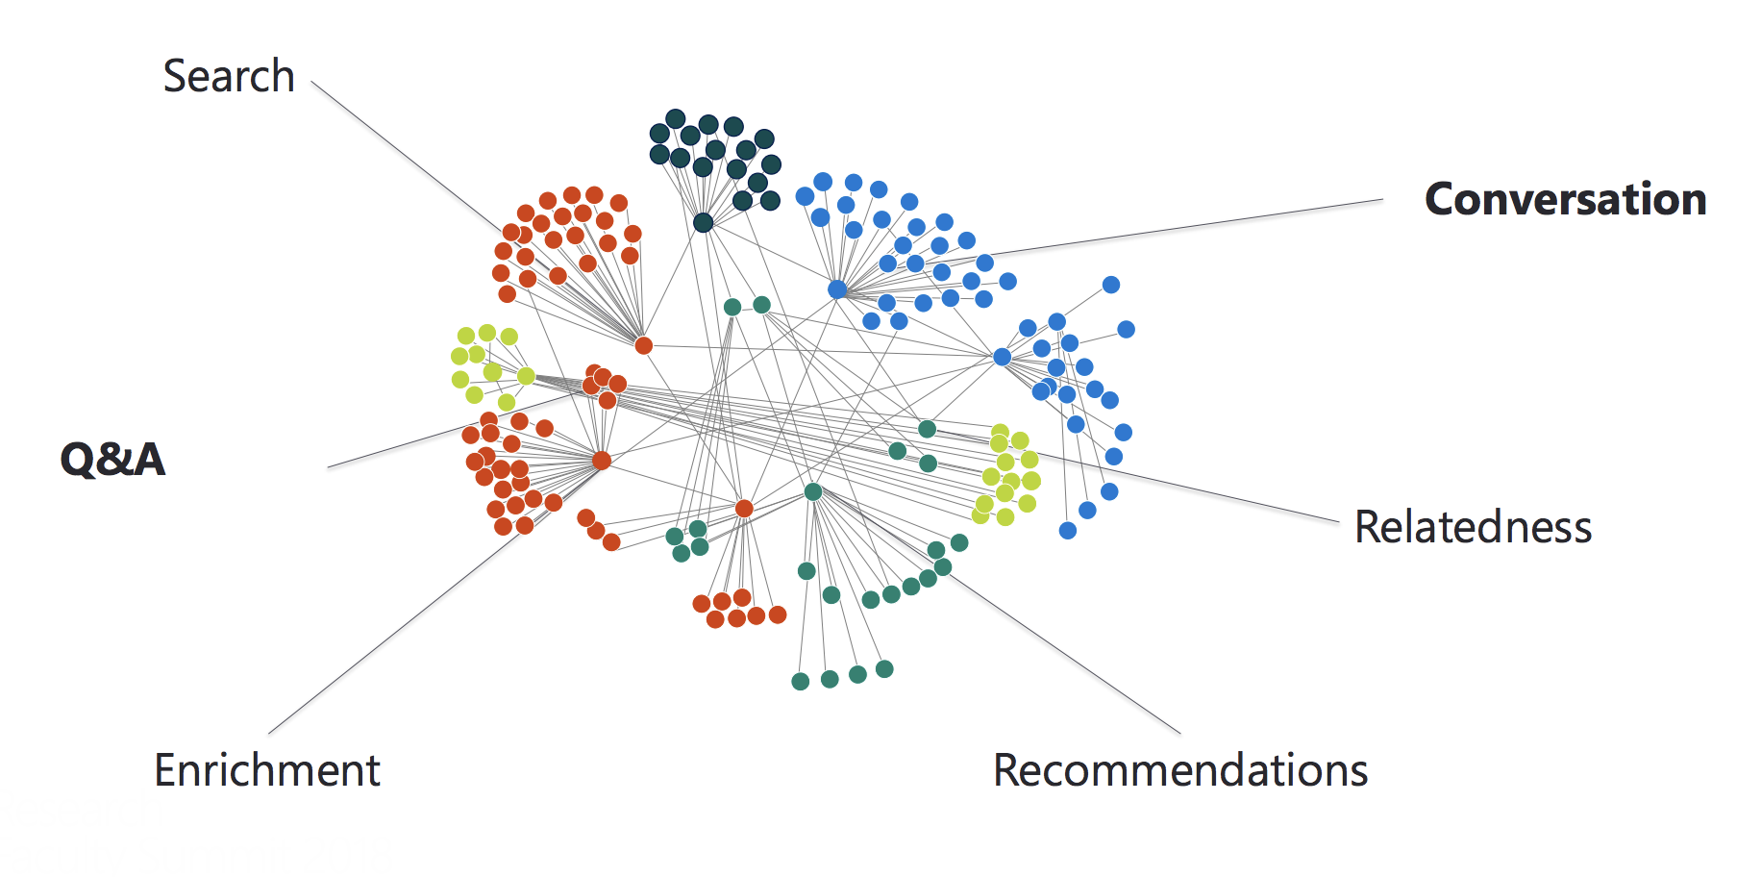
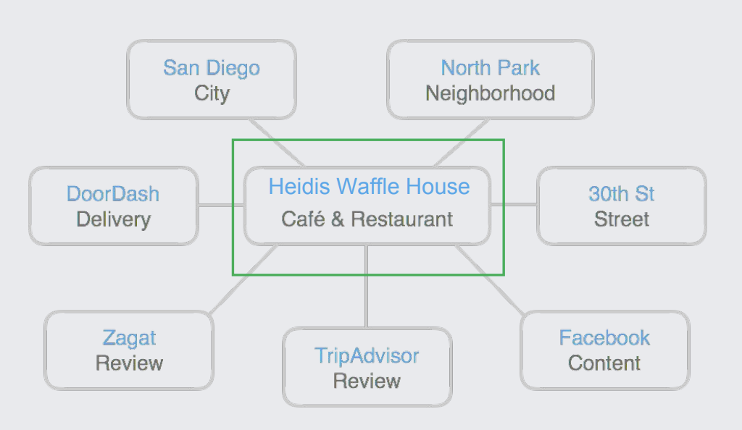
Knowledge graphs in industry

Slide 10
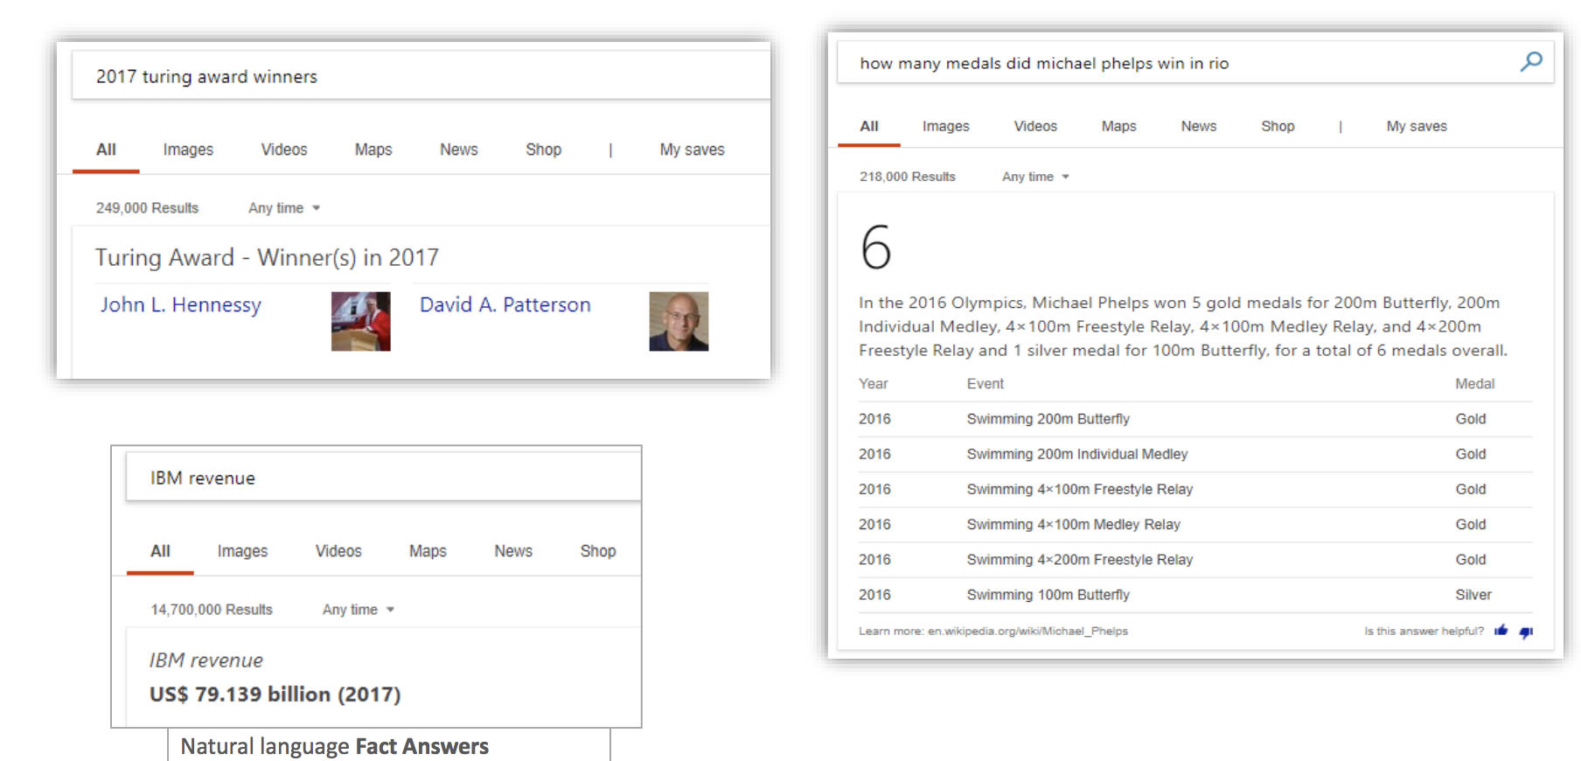
Knowledge Graph use cases

Slide 11
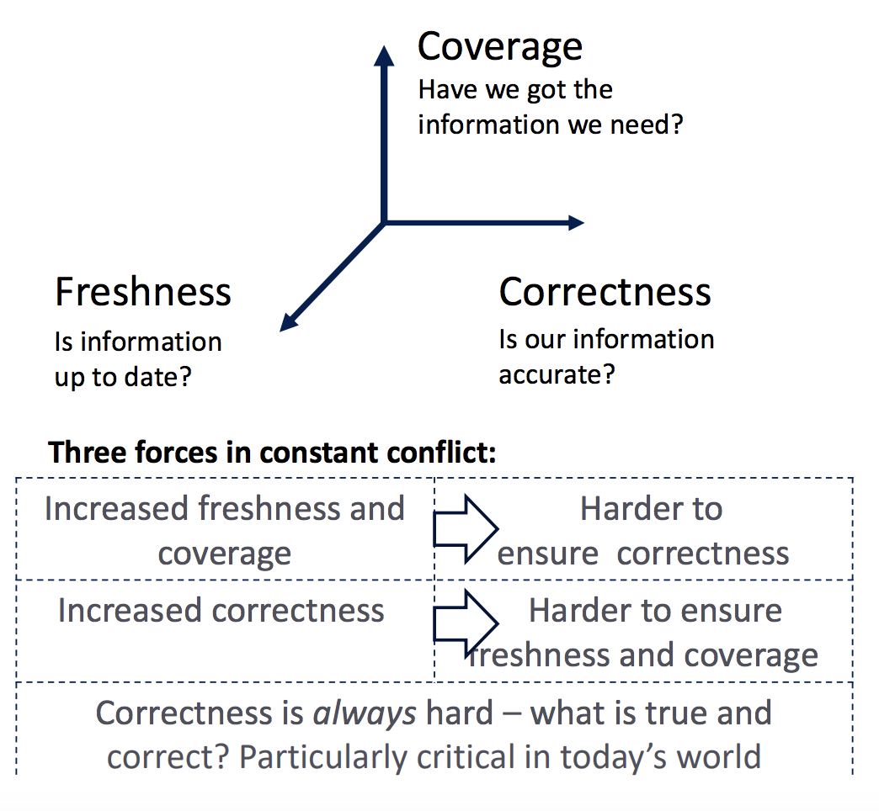
Knowledge Graph challenges
Notes:
Iswc 18: http://iswc2018.semanticweb.org/panel-enterprise-scale-knowledge-graphs/index.html

Slide 12
Uber Eats knowledge graph & query understanding https://eng.uber.com/uber-eats-query-understanding/
Help customers find the exact food/restaurant they want - What is the customer looking for?
What is the customers intent with the following queries?
“bubble tea”, “Asian”, “Indian”, “Hong Kong Grand Buffet”
Customer searches for “udon”, but orders “soba” – what insights can you get from this?
User experience: what if the customer is searching for “Hong Kong Grand Buffet” but its not in their delivery area?

Slide 13
Uber Eats knowledge graph & query understanding https://eng.uber.com/uber-eats-query-understanding/

Slide 14
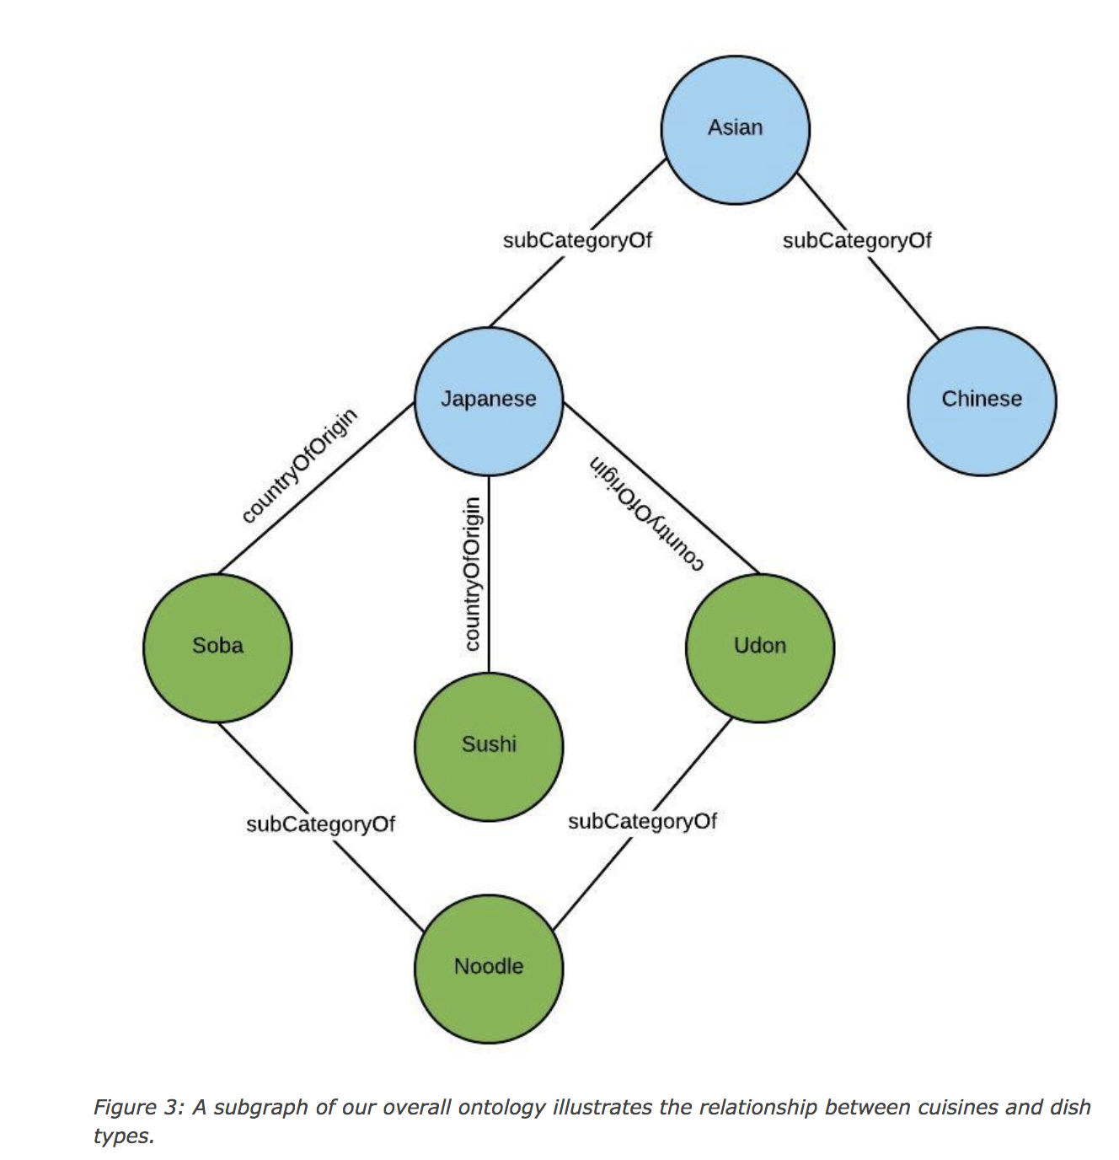
Uber Eats knowledge graph & query understanding https://eng.uber.com/uber-eats-query-understanding/

Slide 15
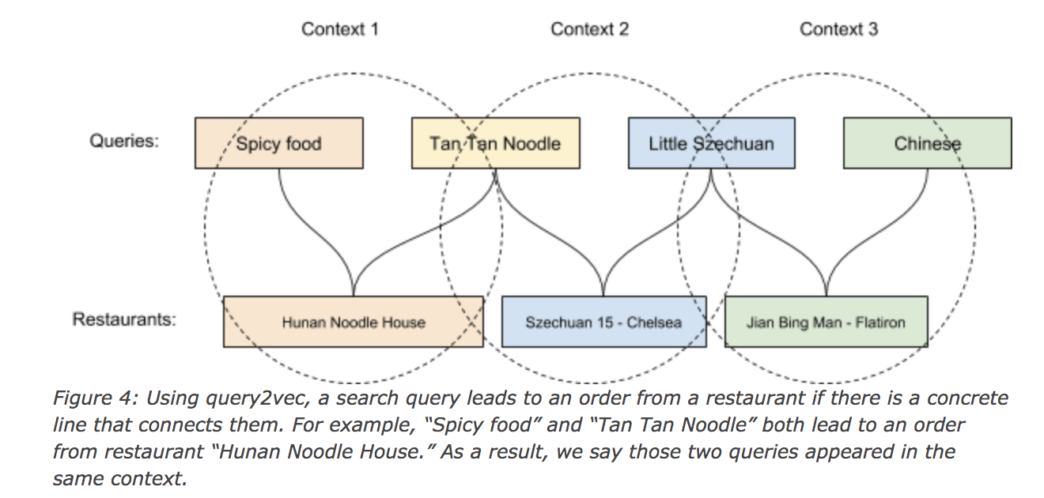
Uber Eats knowledge graph & query understanding https://eng.uber.com/uber-eats-query-understanding/

Slide 16
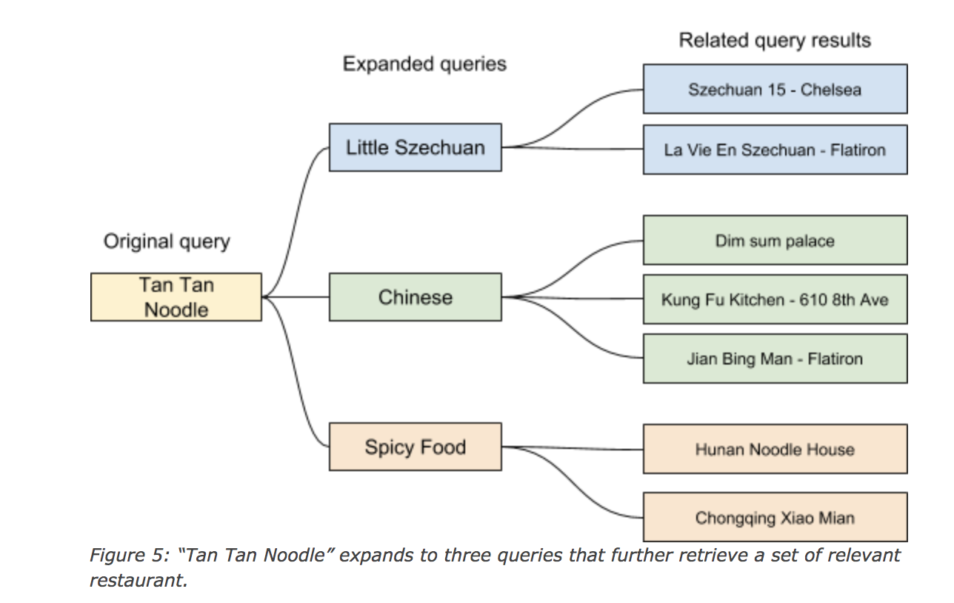
Uber Eats knowledge graph & query understanding https://eng.uber.com/uber-eats-query-understanding/

Slide 17
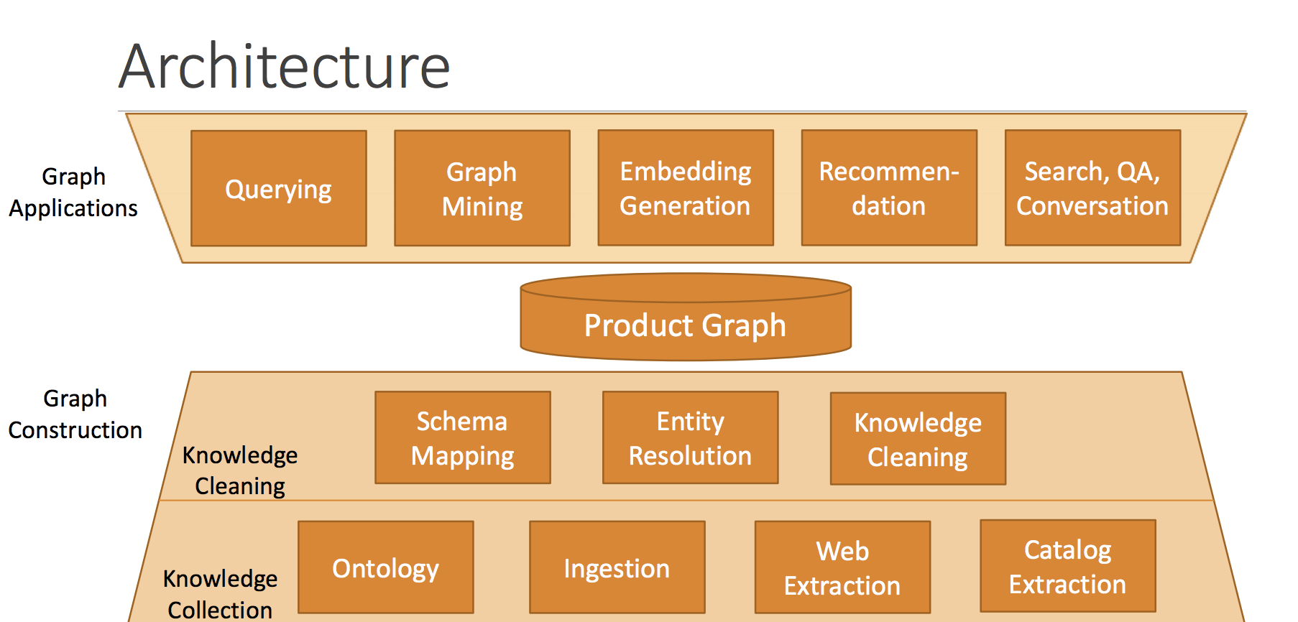
Knowledge Graph Construction

Slide 18
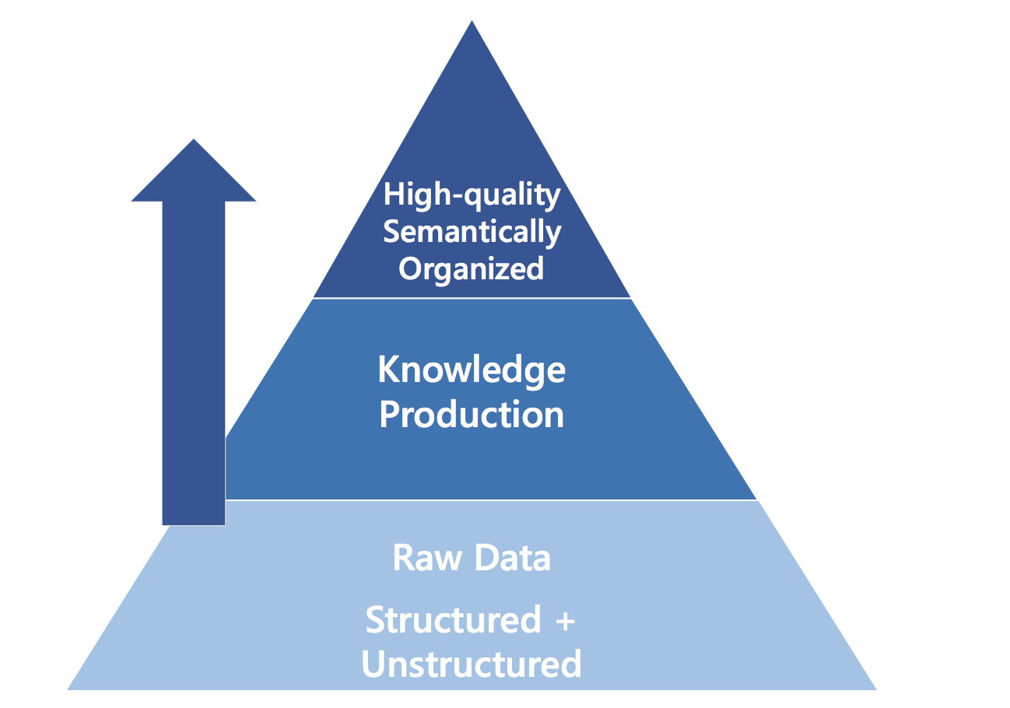
Knowledge Graph Construction

Slide 19
Knowledge Graph Construction
Ingest knowledge from structured and unstructured sources
Structured sources: relational databases, data feeds, catalogs, directories et al
Unstructured sources: Web pages, news and forums, emails, social media, catalog, speech, images, video
Web pages: extract user-designated data from web resources to structured form
Rule-based: regular expressions, wrapped programming languages
Tree-based: segment DOM into data regions, then extract with partial alignment
Machine Learning based

Slide 20
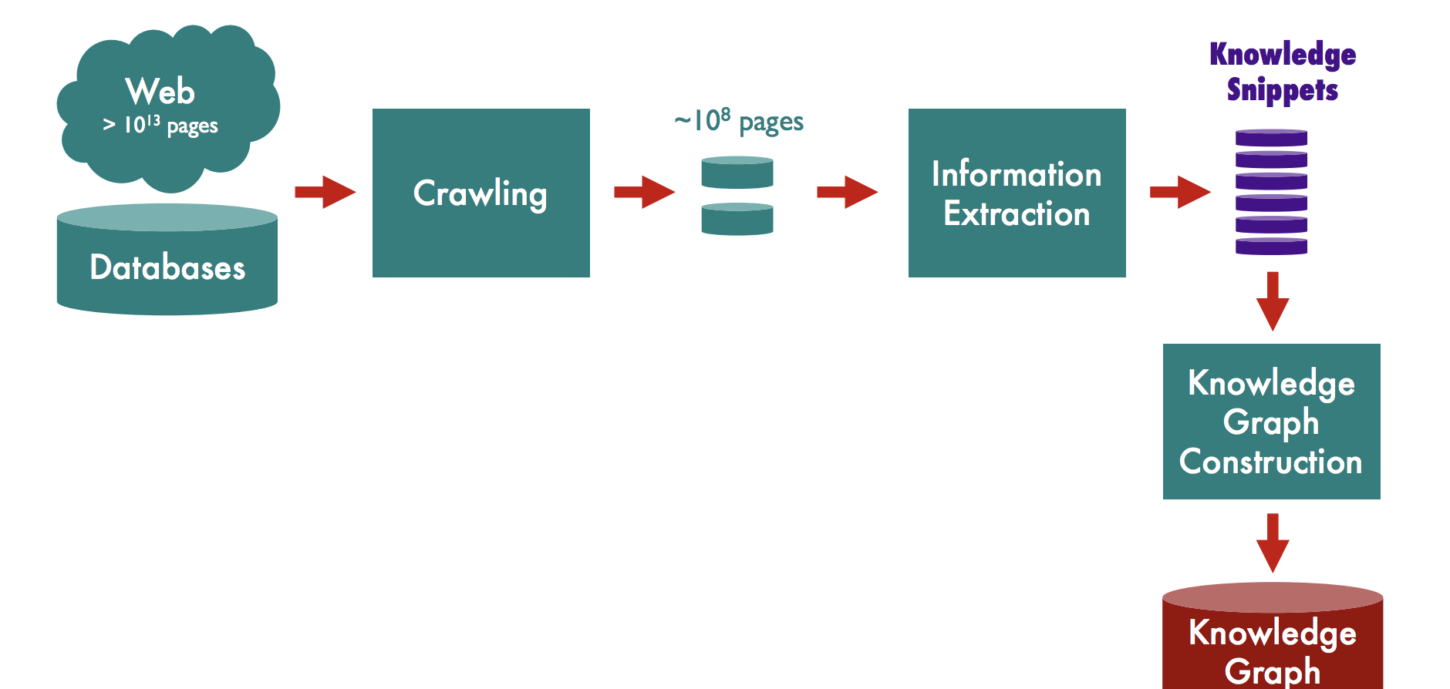
Knowledge Graph Construction
Notes:
USC KDD17 tutorial: Data Mining in Unusual Domains with Knowledge Graph Construction, Inference and Search
https://usc-isi-i2.github.io/KDD17/

Slide 21
Knowledge Graph Construction
Domain discovery: identifying relevant sites, datasets and pages
Crawling: building models of relevant content, identifying new content, overcoming anti-crawling measures
Crawling tools:
Apache Nutch (highly scalable web crawler)
Deep Dive (adaptive crawler – reinforcement learning to learn which links to follow)
ScrapingHub

Slide 22
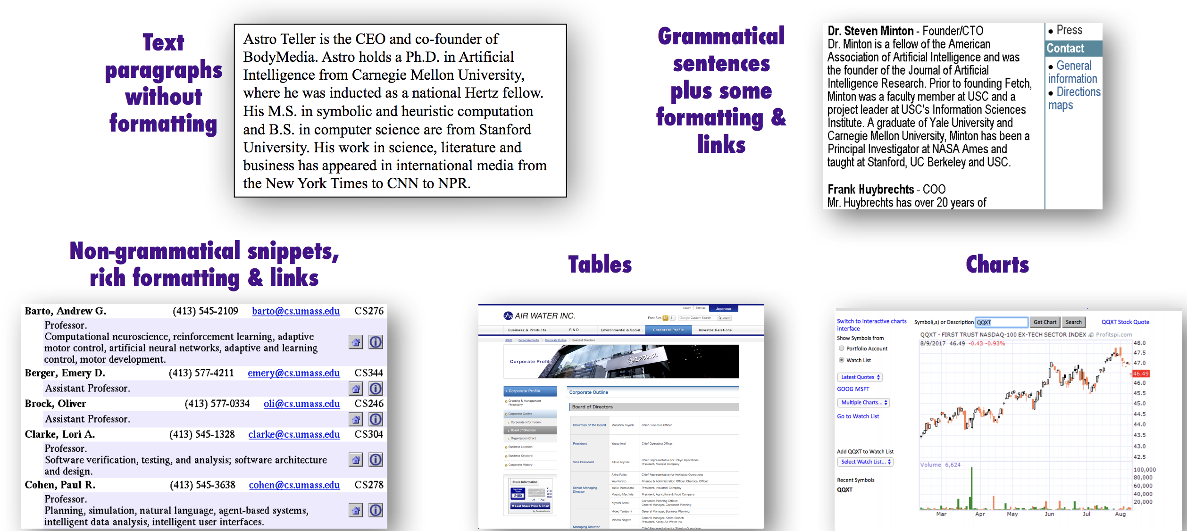
Dimensions of Information Extraction
Document features, Scope, pattern complexity, Relevance
DOCUMENT FEATURES

Slide 23
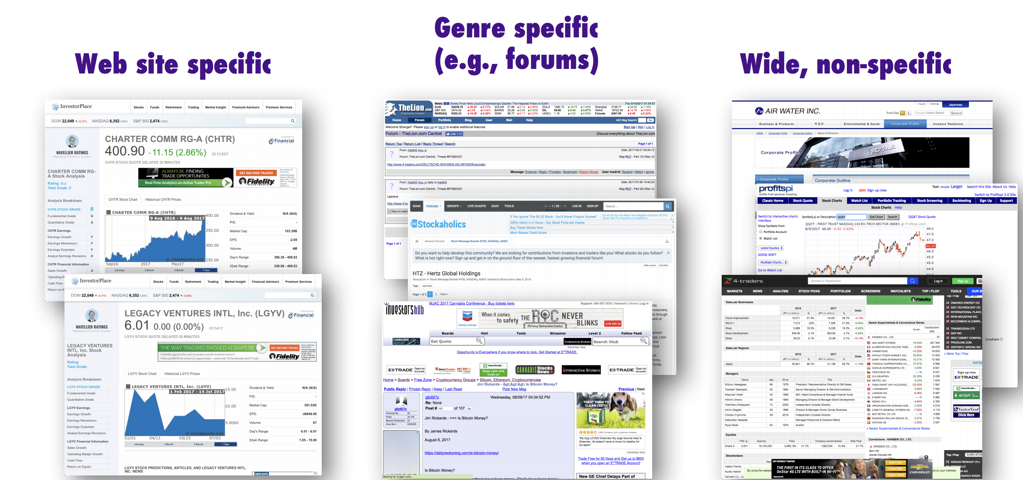
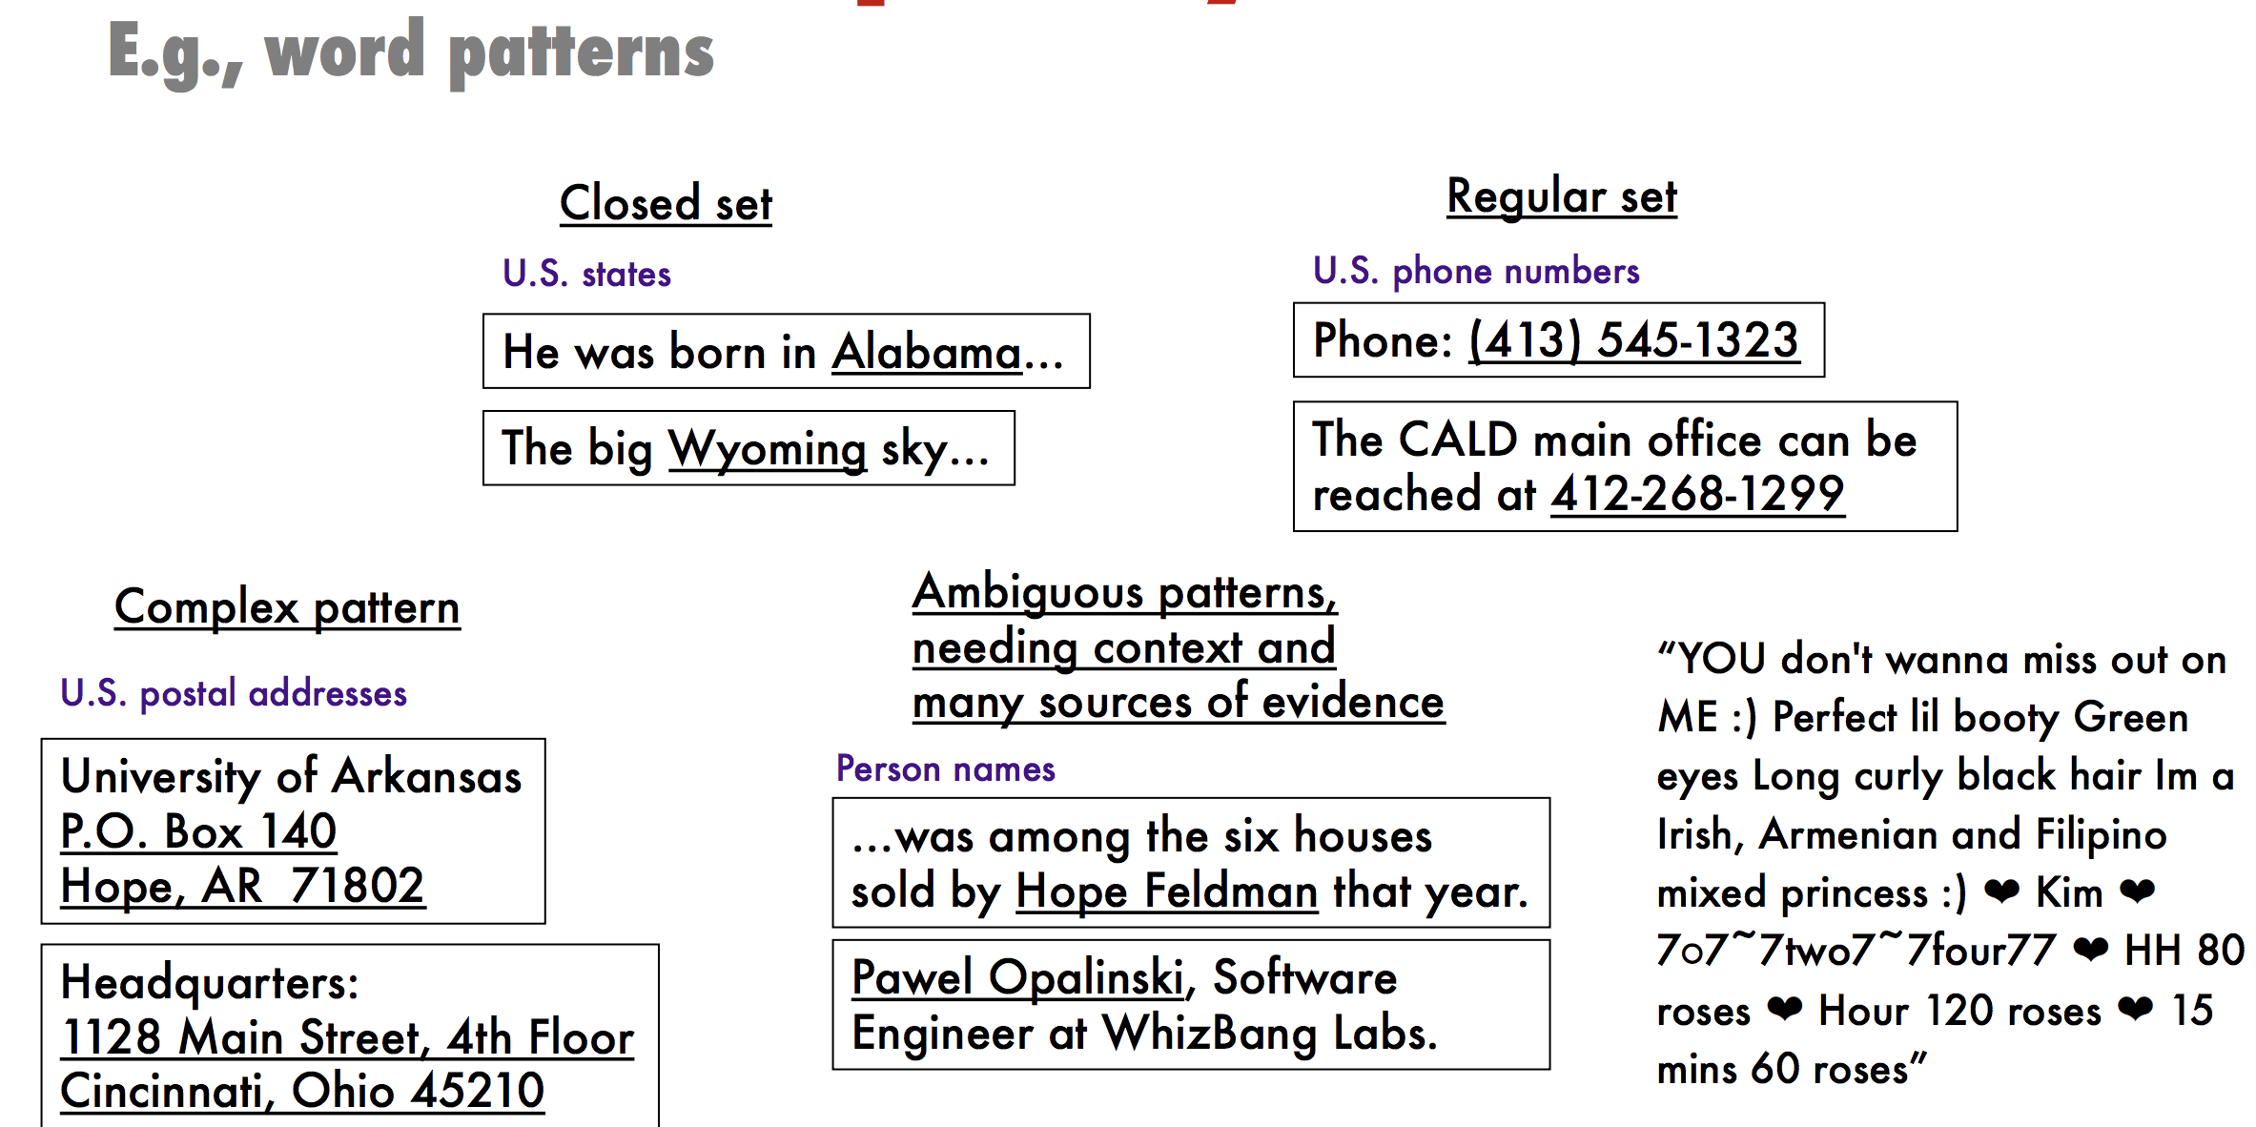
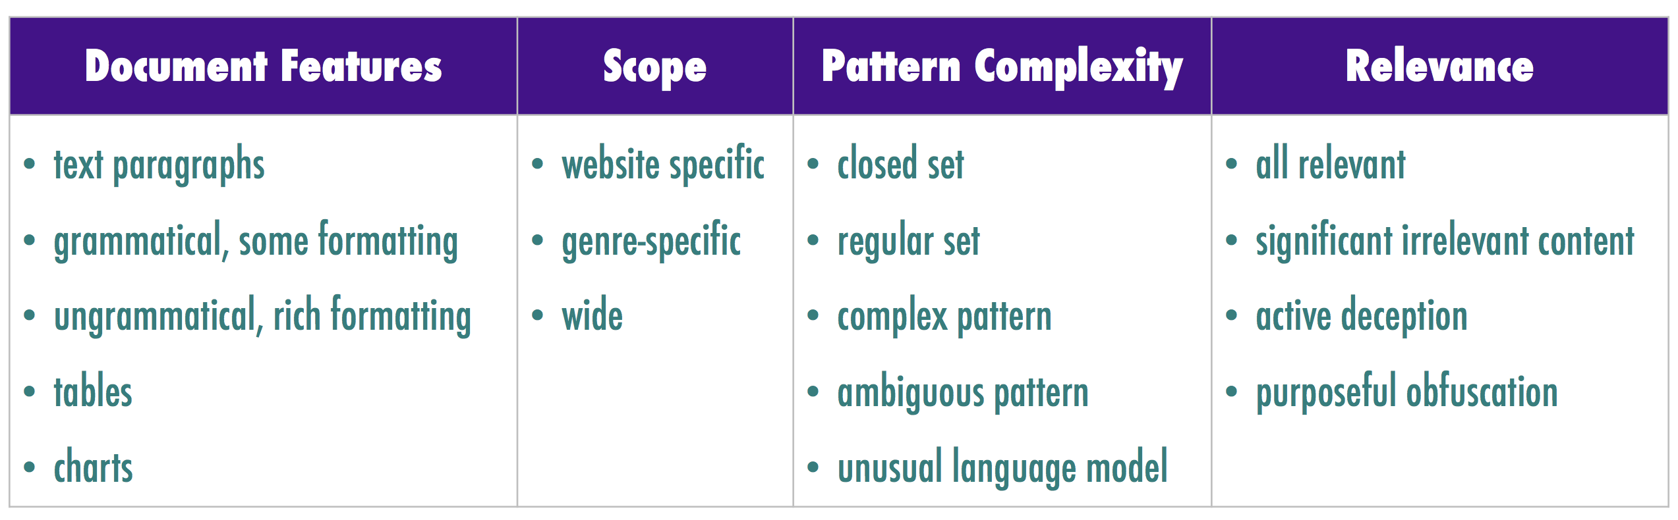
Dimensions of Information Extraction
Pattern Complexity
Scope

Slide 24
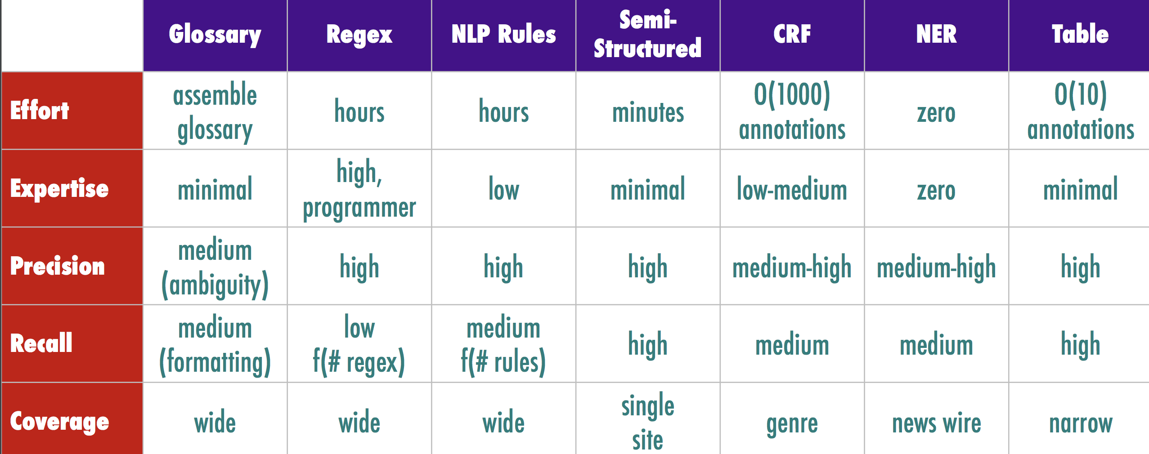
Information Extraction Technologies
High precision when showing extractions to users, and high recall when ranking results

Slide 25
Glossary Extraction
List of words and phrases to extract
Challenges:
Ambiguity: Charlotte is a name of a person and a city
Colloquial expressions: “EU Broadband, Inc.”, vs “EU Broadband”
Research:
Improving precision of glossary extractions
Extending glossaries automatically

Slide 26
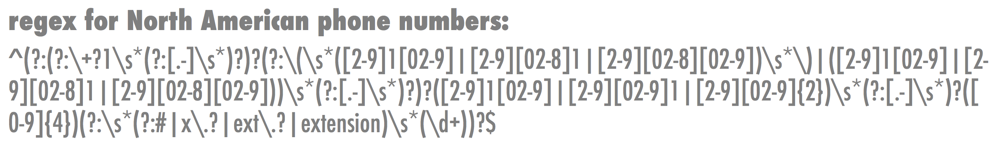
Extraction using Regular Expressions
Too difficult for non-programmars
Brittle and difficult to adapt to some domains:
Unusual nomenclature and short-hands

Slide 27
NLP rule—based extraction
Tokenization for unusual domains :
tokenize on white-space, punctuation and emojis.
Token properties:
Literal, POS, lemma, in/out of vocabulary
Dependency parsing relationships (advanced)
Type (alphanumeric, alphabetic, numeric)
Shape (pattern of digits and characters), capitalization, prefix and suffix
Pattern
Sequence of required/optional tokens, positive and negative patterns
Brittle and difficult to adapt to some domains:
Unusual nomenclature and short-hands

Slide 28
Named-Entity Recognizers
Machine Learning models (CRFs, bi-LSTM-CRF):
People, places, organizations, et al
SpaCy:
Complete NLP toolkit, Python (Cython), MIT License
Stanford NER:
part of Stanford’s NLP software library, Java, GNU license
Zalando Research: Flair NLP
Facebook PyText
Brittle and difficult to adapt to some domains:
Unusual nomenclature and short-hands

Slide 29
What did you learn today?
Questions?

